Slide 1
Multi Campus Network Simulation
Prepared By: Abdul Rehman Course: Computer Communication and Networks Presentation Duration: 30-45 Minutes

Slide 2
Introduction
Multi-campus network designed using Cisco Packet Tracer
Simulates real university communication system
Includes LAN and WAN integration
Supports wired and wireless communication
Focus on scalable network architecture

Slide 3
Aim of the Project
Design a scalable multi-campus network
Connect campuses through WAN
Implement Static IP and DHCP
Improve communication and network management
Ensure reliable connectivity

Slide 4
Problem Statement
Communication gap between campuses
Difficult network management
Limited scalability in traditional networks
Need for centralized networking solution

Slide 5
Objectives
Design multi-campus topology
Configure Routing Information Protocol (RIP) dynamic routing
Apply subnetting techniques
Implement Static Internet Protocol (IP) and Dynamic Host Configuration Protocol (DHCP)
Verify end-to-end communication

Slide 6
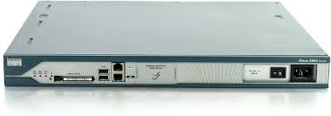
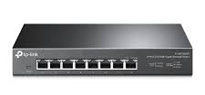
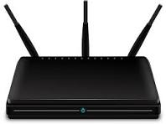
Technologies and Devices
Software
Cisco Packet Tracer
Protocols
Transmission Control Protocol / Internet Protocol (TCP/IP)
Routing Information Protocol
Router-2811
Switch 2950T-24
Access Point

Slide 7
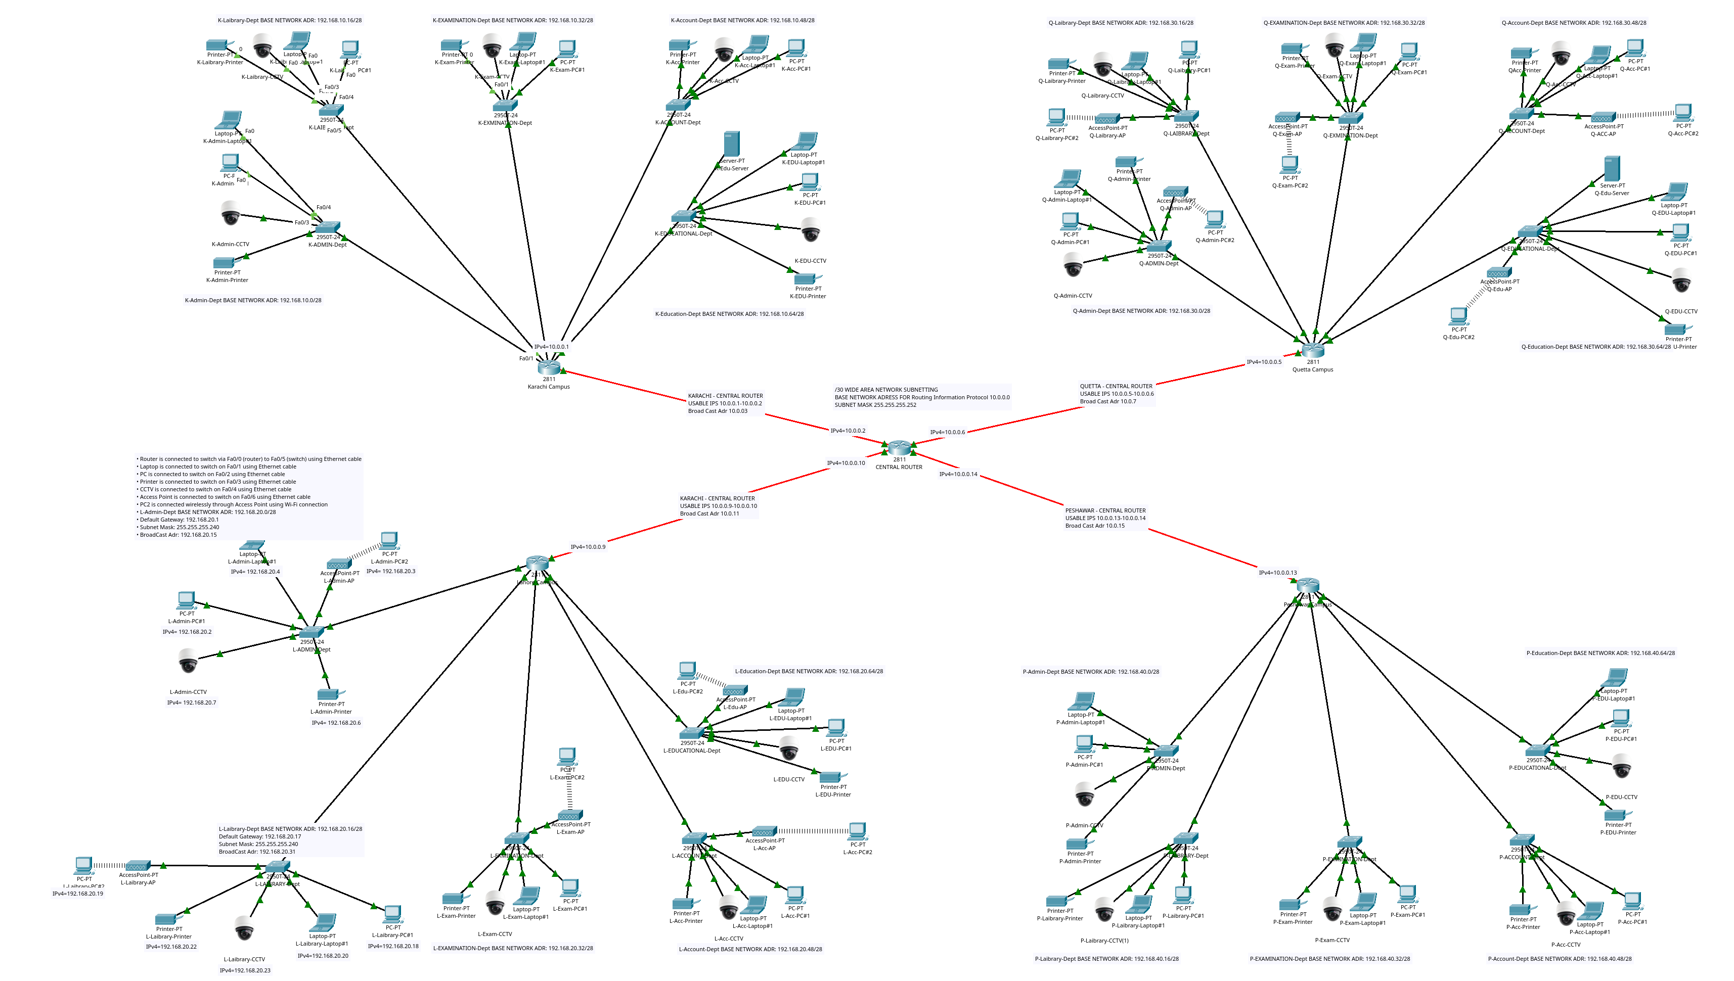
Network Overview
Four campuses interconnected through WAN
Each campus has independent LAN
Departmental subnetting applied
RIP used for dynamic routing
Hybrid wired and wireless design

Slide 8
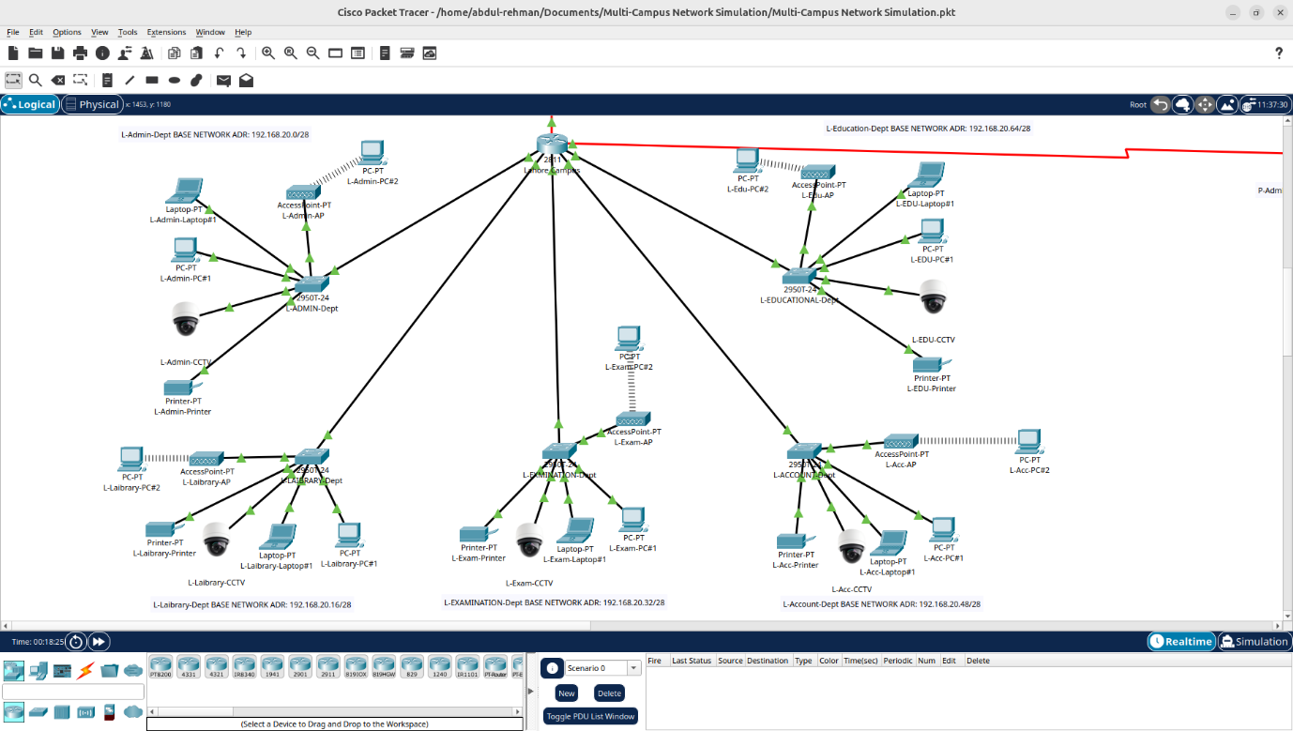
Campus & Department Structure
Campuses
Karachi Campus
Lahore Campus
Quetta Campus
Peshawar Campus
Departments
Administration
Library
Examination
Accounts
Education

Slide 9
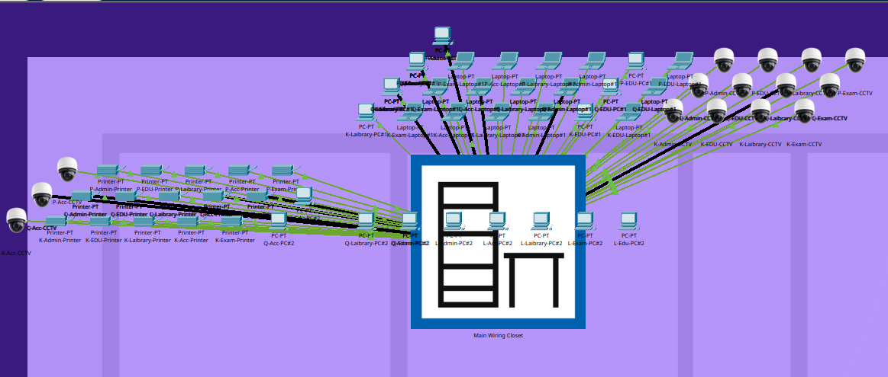
Physical Topology
Physical Topology
Routers connected through serial links
Switches used for LAN communication
Ethernet used for wired devices
Logical Topology
Separate subnet for each department
IP-based segmented network
Point-to-point WAN addressing used

Slide 10
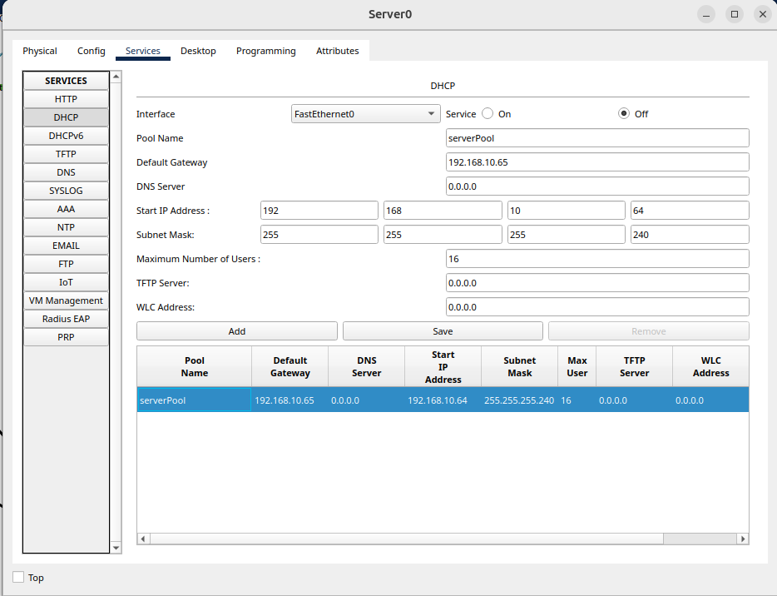
IP Addressing & DHCP
IP Addressing
Campus – Network
Karachi – 192.168.10.0
Lahore – 192.168.20.0
Quetta – 192.168.30.0
Peshawar – 192.168.40.0
Configuration
Static IP used for routers and servers
DHCP used for automatic client addressing
Private Class C addressing implemented

Slide 11
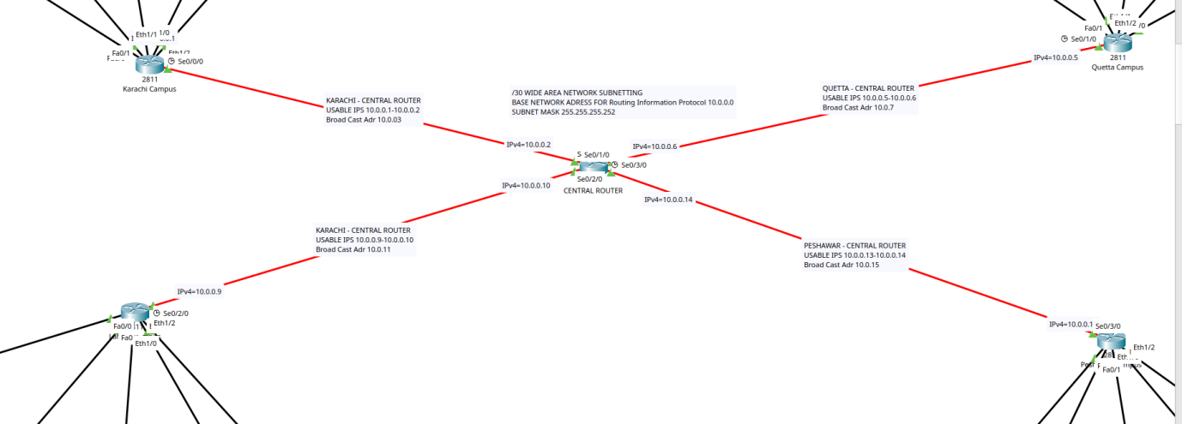
LAN/WAN Subnetting and Routing
LAN Subnetting
Default Mask: /24
Used Mask: /28
Efficient IP utilization achieved
WAN Subnetting
WAN Network: 10.0.0.0/30
Used for router-to-router communication
Routing
RIP enabled dynamic routing
Automatic route sharing achieved

Slide 12
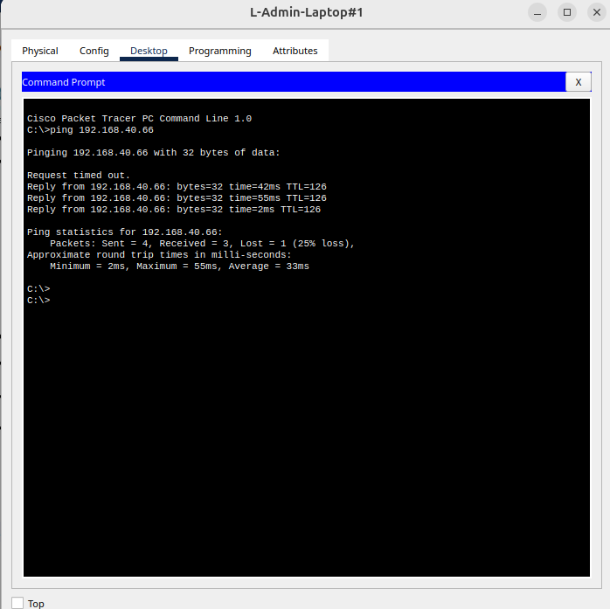
Configuration, Testing & Verification
Configuration
Devices configured in Cisco Packet Tracer
Static and DHCP addressing implemented
RIP routing configured successfully
Testing & Verification
Ping command used for testing
Wired and wireless connectivity verified
Successful end-to-end communication achieved

Slide 13
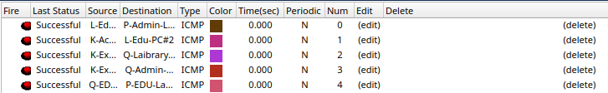
Project Achievements
Achievements
Successful LAN and WAN integration
DHCP and Static IP implemented
Efficient subnetting applied
Dynamic routing configured using RIP
Reliable multi-campus communication achieved

Slide 14
Conclusion and Q/A
Multi-campus network successfully designed
Reliable inter-campus communication achieved
Efficient IP management implemented
Scalable architecture developed for future expansion

Slide 15
THANK YOU

